Slide 1
Introducing Mediant for Your Investor Communications
Katie Green
Director, Product Management
Lindsey Semptimphelter
Senior Relationship Manager, Mediant
March 2022

Slide 2
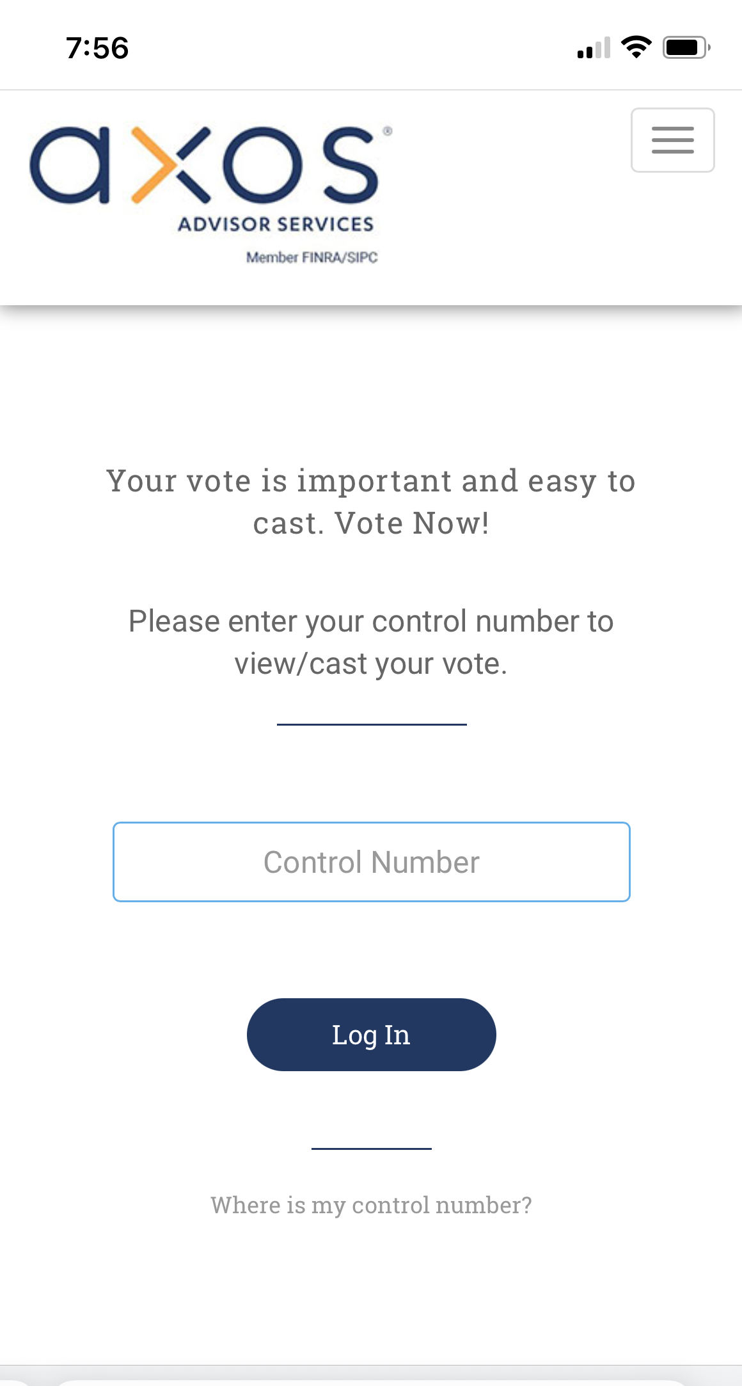
Advantages
What are the advantages of using Mediant?
On-line access to all communications
RIAs can view notices and make selections as needed for:
Voluntary Corporate Action Notices
Mandatory Corporate Action Notices
Proxy Voting Information
Post-Sale Fulfillment - Prospectus Information
Includes 6 months of History!
Includes client position details!
Timely Notifications and Elections
Emailed Event Notifications – Informs RIAs when action needed
View account holdings – act on all accounts or select accounts
Voluntary Corporate Actions – no need to email elections
Investor Client Experience
Investors can access on-line, even if getting paper notices
Easy voting using mobile app
Consistent and modern client communications, all branded to AAS
Proactive information about failed email deliveries
Extensive tracking of emails and documents sent means faster answers to client inquiries

